Slide 1
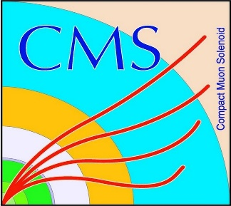

HEP Weekly Report
George Bakas
NTUA

Slide 2
Progress Report
DCS
dbEditorAndNavigator in fwInstallationUtils component
Bug fixes
Redundancy task
ArdEnvino
Made changes to the board
Will check with Florian and proceed with new board
HGCAL
Test beam ended yesterday
Analysis
Theoretical top anti-top pair spin correlation in fully hadronic decay
Finally production with data (how to use CMSSW, crab etc)
Next step is 2017 MC

